Slide 1



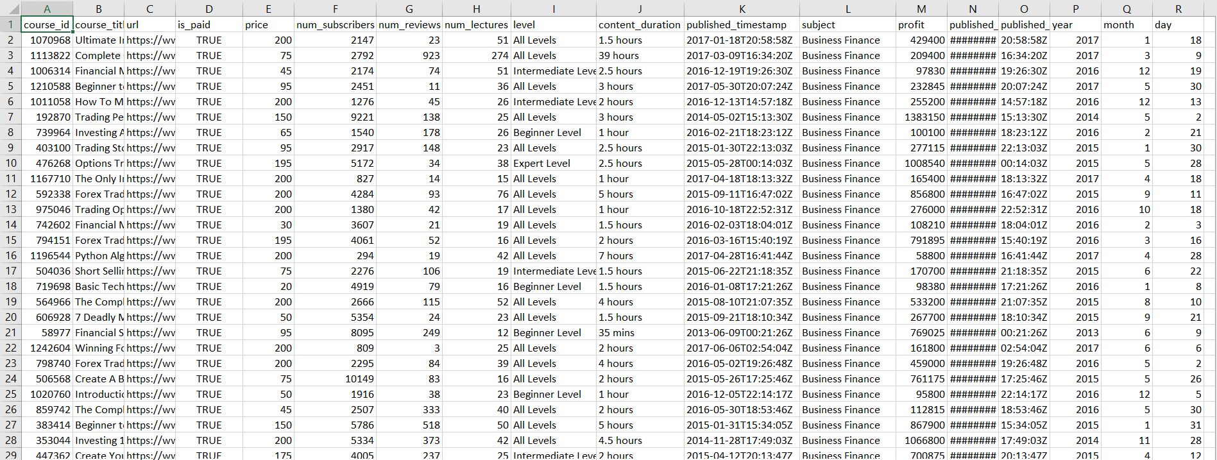
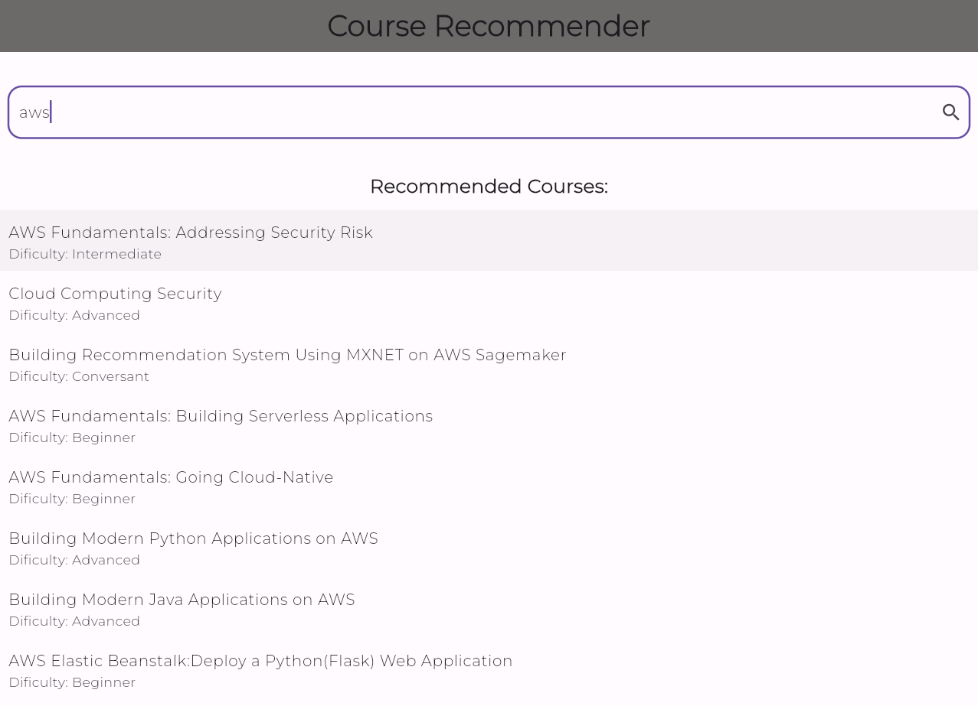
COURSE RECOMMENDATION SYSTEM
Department of Computer Science & Engineering
School of Computing
10214CS602 – MINOR PROJECT
WINTER SEMESTER 2023-2024
ABSTRACT
INTRODUCTION
RESULTS
STANDARDS AND POLICIES
The Course Recommendation System (CRS) aids users in selecting online courses aligned with their interests through two distinct approaches: quick identification of similar courses for smaller datasets and comprehensive understanding of course content for larger datasets. Utilizing k-NN algorithm and TF-IDF vectorizer, the system combines linguistic and numerical analyses to enhance recommendation accuracy. Initial user input on favorite subjects and learning methods informs the system's intelligent design, transforming preferences into a functional prototype. Continuous improvements are made via user feedback and rigorous testing to ensure ongoing usefulness and user satisfaction.
The Course Recommendation System (CRS) aims to simplify course selection by providing personalized recommendations based on user preferences, utilizing advanced algorithms and user input. It recognizes the challenge of navigating a vast educational landscape and seeks to enhance satisfaction by providing a dynamic, personalized platform. With continuous refinement based on user feedback, the system ensures adaptability to evolving learning preferences. By harnessing machine learning techniques such as TFIDF vectorization and the k-Nearest Neighbors algorithm, the CRS analyzes course descriptions to suggest relevant learning opportunities aligned with individual interests. This innovative application not only streamlines course discovery but also enhances the overall learning experience by aligning educational content with individual needs
The proposed system combines TF-IDF vectorization and k-NN algorithm for course recommendations, efficiently capturing course details and offering effectiveness. While effective for popular courses, its accuracy may decline for newer or less-known ones due to reliance on existing data. In contrast, the existing k-NN system works well for smaller datasets but struggles with larger collections, potentially missing matches and slowing down. By comprehensively understanding courses, the proposed system provides precise recommendations akin to a knowledgeable friend, ideal for vast libraries of courses.
Flutter:
Flutter is an open-source UI (User Interface) toolkit developed by Google for building natively compiled applications for mobile, web, and desktop from a single codebase. It uses the Dart programming language and follows a reactive programming paradigm.
Standard Used: ISO 25010.
Python:
Python stands out in the realm of machine learning due to its simplicity, readability, and expansive library ecosystem tailored for ML tasks. With frameworks like TensorFlow, PyTorch, Scikit-learn, and Keras, Python offers a robust toolkit for data manipulation, model building, and evaluation, streamlining the entire ML workflow.
Standard Used: PEP 257
CONCLUSIONS
Our course recommendation project acts like a knowledgeable assistant guiding users to discover courses aligned with their interests. It's akin to a savvy companion who comprehends your preferences and offers suggestions based on that understanding. Using diverse technologies, we crafted a smart backend responsible for understanding your preferences, while the frontend, the part you see and interact with on your device, presents these recommendations in a user-friendly manner.
Fig : Data Collection and Processing
TEAM MEMBER DETAILS
METHODOLOGIES
1. Vtu19381/P.RAJASEKHAR REDDY
2. Vtu19934/P.DEVENDAR REDDY
3. Vtu20580/S.HARSHA VARDHAN REDDY
1. 6301805230
2. 8008023714
3. 6301199381
1. vtu19381@veltech.edu.in
2. vtu19934@veltech.edu.in
3. vtu20580@veltech.edu.in
Step 1: Collection of data
Step 2: Processing the data
Step 3: Using Vectorization
Step 4: Using KNN Algorithm
Step 5: The output
ACKNOWLEDGEMENT
Supervisor Name : Mr. Sankar Ganesh K /Assistant Professor
Phone Number: 99622 40165
Email: ksankarganesh@veltech.edu.in
Fig : Output of Course Recommendation System

